Slide 1
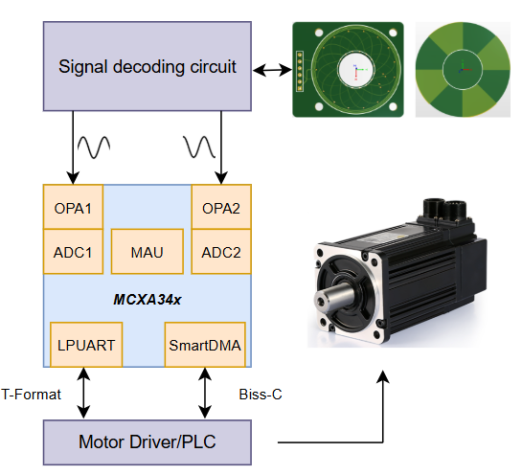
Dual-Track Inductive Encoder based on MCXA34x
Compact hollow-shaft hardware with 16/15 Vernier absolute-angle output
Key Advantages
Dual RX coil PCB / rotor
• Ultra-thin hollow-shaft PCB form factor
• 16/15 Vernier dual-track absolute angle
• High immunity to magnetic field interference
↓
Track A1
16-cycle sin/cos
AS5715R #1
Track A2
15-cycle sin/cos
AS5715R #2
Core Features
↓
↓
RC filter / OPA / TLV9062
• Dual AS5715R paths for 16-cycle and 15-cycle tracks
• 4-channel synchronous LPADC sampling
• Offset, gain, phase and ellipse correction
• atan2 phase extraction and Vernier branch solve
• Type-II software PLL with velocity output
• Flash calibration with CRC and fallback defaults
• T-Format, BiSS-C and FreeMASTER support
↓
MCXA344
sync LPADC0/1
atan2 + 16/15 Vernier
Type-II PLL
↓
T-Format / BiSS-C / FreeMASTER
↓
Target Applications
Motor Driver / PLC / Host
• Robotic joint modules
• Heavy-load gimbals
• Servo motors
• Automotive actuators (EMB, SBW)

Slide 2
Second-Generation Dual-Track Encoder Principle
Two electrical tracks resolve both fine phase and absolute branch in one turn
Upgrade Concept
Dual RX coil PCB
16-cycle + 15-cycle
tracks
Rotor target
single mechanical
turn
↔
Ø Two sensing tracks on one rotor-stator set
Ø 16-cycle track provides fine electrical phase
Second-generation sensing principle
Ø 15-cycle track resolves the absolute branch
Track A1
16 electrical cycles
sin16 / cos16
Track A2
15 electrical cycles
sin15 / cos15
Vernier Angle Synthesis
Ø phi16 - phi15 changes once across a full turn
Ø phi16 refines the sub-cycle position
↓
↓
Ø Absolute 0-360° angle without magnet or gear
MCXA344 analog front end
OPA / TLV9062 + synchronized LPADC
System Benefit
↓
Ø 16-bit single-turn output for servo-class feedback
Ø Branch-slip guard improves single-frame glitch immunity
Vernier absolute-angle solve
coarse = wrap(phi16 - phi15)
angle = coarse + (phi16 - 16·coarse) / 16
Ø Multi-turn accumulation remains firmware-managed
↓
16-bit single-turn absolute angle
plus RAM multi-turn accumulation

Slide 3
Second-Generation Decoding Flow
Calibration, Vernier solving and tracking convert raw signals into stable results
Signal Path
4-channel LPADC
A1/A2 sine and cosine sampled synchronously
Ø Four ADC channels capture A1/A2 sin/cos pairs
Ø Offset, gain and phase errors are calibrated
↓
Ø atan2 converts normalized vectors to track phase
Ellipse correction
center removal + T matrix normalization
Stability Layer
Factory
calibration
center, ellipse,
zero
↓
Runtime trim
mag window +
AGC
Ø Type-II software PLL publishes a low-noise angle
atan2 phase extraction
phi16 and phi15 per sample
Ø Velocity estimate is generated inside the tracker
↓
Ø Output hysteresis suppresses static display jitter
16/15 Vernier solver
branch selection + fine-angle refinement
Production Readiness
↓
Diagnostics
weak / rail /
mismatch
Ø Flash calibration storage with CRC and fallback defaults
Type-II tracking observer
stable angle and velocity output
Ø Runtime trim compensates amplitude drift over a revolution
Ø Status bits report weak tracks, ADC rail and mismatch
↓
Published results
angle_counts, multi_turn_deg, status

